Slide 1
Mobile Application Development
Introduction, Basic Concepts, Mobile OS

Slide 2
Course Learning Outcomes:
Upon successful completion of the course, the student will be able to:
CLOs | Description | Taxonomy level | PLO
1 | Explain the basic concepts used in various Mobile Application Development Frameworks. | C3 | 1
2 | Use mobile application components and compare the different performance trade-offs | C4 | 2
3 | Create mobile application solutions to real world problems | C5 | 3
4 | Develop mobile applications using current software development environments | P3 | 5

Slide 3
Marks Distribution
CLO 1 and CLO 2 - Mid terms and Final Exam - 80 Marks
CLO 3 – Semester Project and Assignments - 20 Marks
CLO 4 – Practical Class – 50 Marks

Slide 4
What is Mobile?
Able to move or be moved freely or easily.
Technically defined as :
“relating to mobile phones, handheld computers, and similar technology”.
Putting something into operation
Technically defined as:
“A computer program designed to perform a specific task for the user”.
What is an Application?

Slide 5
What is mobile computing?
A simple definition could be: Mobile Computing is using a computer (of one kind or another) while on the move
Another definition could be: Mobile Computing is when a (work) process is moved from a normal fixed position to a more dynamic position.
A third definition could be: Mobile Computing is when a work process is carried out somewhere where it was not previously possible.
Mobile Computing is the technology used for transmitting voice and data through small, portable devices using wireless enabled networks.

Slide 6
Applications of Mobile Computing
Emergency Services
In companies
Stock Information Collection/Control
Credit Card Verification
Taxi/Truck Dispatch
Electronic Mail/Paging
Mobile Commerce
Banking and Financial Services
Wireless Electronic Payment Systems
Location based Services
Mobile Shopping
Mobile Entertainment
Mobile games and
Hands-free driving
Wireless Telemedicine
Other Mobile Computing Services for Consumers
Non–Internet Mobile Applications for Consumers

Slide 7
Advantages
No location constraint
It saves time and enhances productivity
It provides entertainment, news and information on the move
Streamlining of business processes
Mobility has enabled streamlining of business processes, cumbersome emails, paper processing, delays in communication and transmission.

Slide 8
Challenges
Disconnection
Low bandwidth
High bandwidth variability
Low power and resources
Security risks
Wide variety terminals and devices with different capabilities
Device attributes
Fit more functionality into single, smaller device

Slide 9
Mobile OS
A mobile operating system (OS) is software that allows smartphones, tablet PCs and other devices to run applications and programs.
Apple iOS
Google Android
BlackBerry OS
Nokia’s Symbian
Hewlett-Packard’s webOS (formerly Palm OS)
Microsoft’s Windows Phone OS

Slide 10

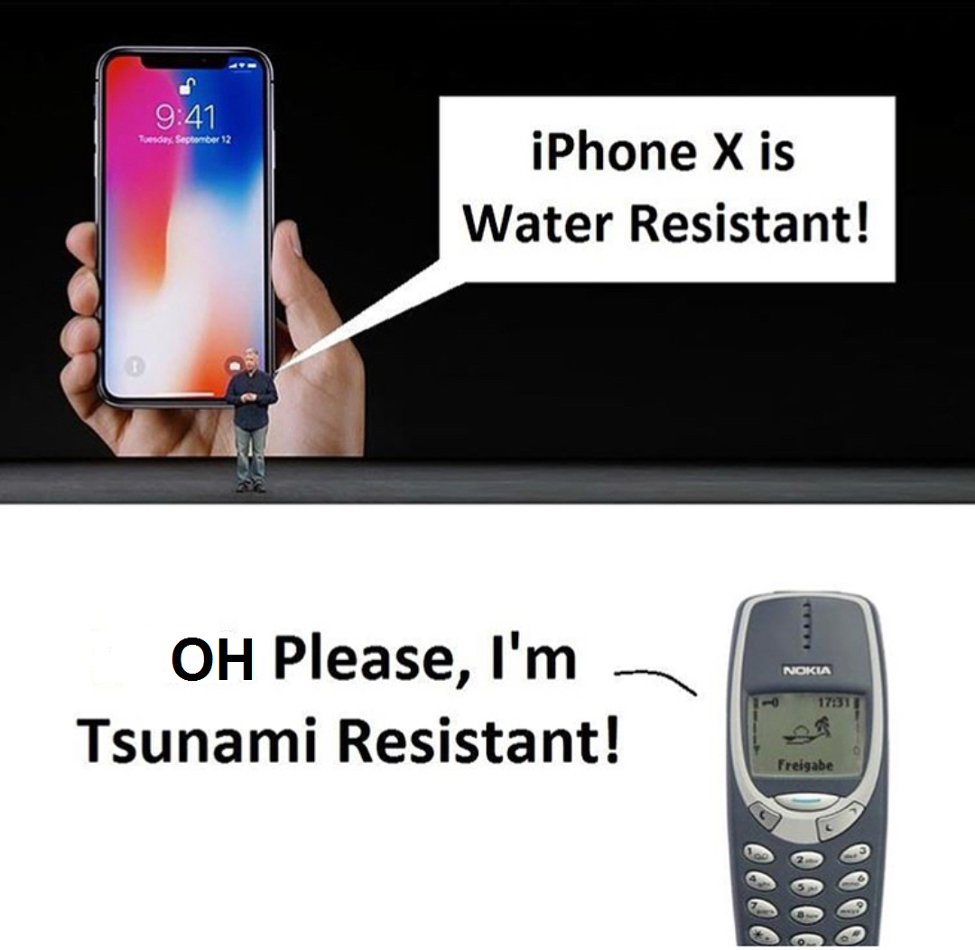
Traditional Trends
Relevant to older mobile systems
Made use of older mobile operating systems such as:
Palm OS
Psion OS
Symbian OS
Technologies used: Specific to the above operating systems such as C/C++, Java mobile edition, WML etc.

Slide 11
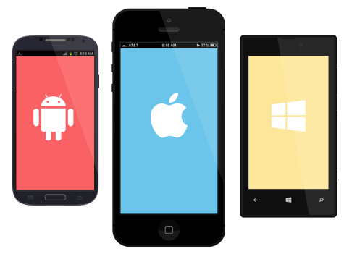
Current Trends
iOS
Android

Slide 12
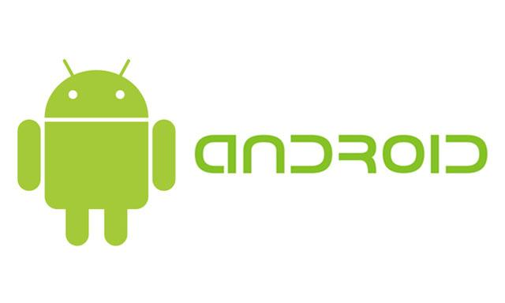
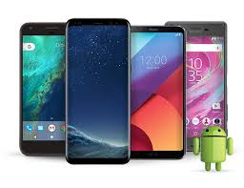
Current Trends (Contd..)
Android
Developed by Google Inc.
Free and open source
Uses Linux operating system
Manufacturer: Oppo, Nokia, Samsung, Huawei, Vivo, Motorola etc.

Slide 13
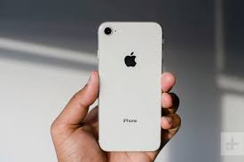
Current Trends (Contd..)
iOS
Developed by Apple in June 2007.
Device Manufacturer: Apple

Slide 14
Current Trends (Contd..)
Mobile Apps Platform | Pros | Cons
iOS | User Experience Security App Quality Faster adoption of latest features | Closed platform Development only on Mac Duplicating core iOS features is prohibited. Publishing apps is expensive.
Android | Free and open source Major share of mobile market (81%) Open content sharing Publishing apps is easy Development on any platform | Fragmentation between different versions of the OS Delay in upgrades Security Concerns

Slide 15

YOUR CHOICE???

Slide 16
Current Trends (Contd..)
Mobile Apps Platform | Development Technology
iOS | System: MAC Programming language: Objective C Development software: Xcode
Android | System: Any system Programming language: Java/ Kotlin Development software: Android studio
Hybrid (3 into 1) | System: Any system Programming language: Dart, Javascript, C# Development Framework: Flutter, React JS, PhoneGap, Xamarin Development software: Android studio, VS Code, Visual Studio

Slide 17
Challenges in building Mobile Applications

Slide 18
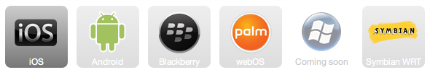
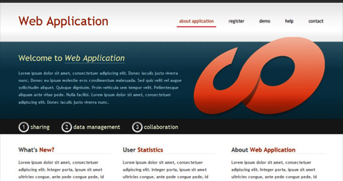

1. OS Fragmentation
Windows 7
Fragmentation

Slide 19
2. Multiple Teams/Product
Windows 7
Multiple Teams/Products

Slide 20






3. Uniform User Experience
Windows 7
Uniform User Experience

Slide 21
Types of Mobile App Development
Native Mobile Apps
Cross Platform Mobile Apps
Hybrid partly Native partly Cross Platform

Slide 22
Native Mobile Apps
When To
When Not To
High Performance Apps
Heavy on OS and Device Features
Complex N/W comm.
Only Few Platforms
Performance is not the main criteria
More or less Replicates Web Apps with few device feature
Standard Restful
Many Platforms

Slide 23
Cross Platform Mobile Apps
When To
When Not To
Performance is not the main criteria
More or less Replicates Web Apps with few device feature
Standard Restful
Many Platforms
Time to market is critical
Saving Cost is critical
High Performance Apps
Heavy on OS and Device Features
Complex N/W comm.
Only Few Platforms

Slide 24
Hybrid Mobile Apps
When To
Why To
Fairly Simple UI
Complex Backend
Quite few platforms
Some parts of app are common
Rest parts are different
Use Cross Platform to develop common part
Use Native to develop the weight-lifting parts

Slide 25
Thank You!

